Slide 1
Bus Reservation System

Slide 2
Why?
Less hustle
Saves time
Reliable
Less Error Prone
Easier to manage company resource

Slide 3
Functional Requirement Customer
Registration

Slide 4
Functional Requirement Customer
Registration ✓
Login

Slide 5
Functional Requirement Customer
Registration ✓
Login ✓
Search

Slide 6
Functional Requirement Customer
Registration ✓
Login ✓
Search ✓
Reserve Seat

Slide 7
Functional Requirement Customer
Registration ✓
Login ✓
Search ✓
Reserve Seat ✓
Cancel

Slide 8
Functional Requirement Customer
Registration ✓
Login ✓
Search ✓
Reserve Seat ✓
Cancel ✓
Edit Profile

Slide 9
Functional Requirement Customer
Registration ✓
Login ✓
Search ✓
Reserve Seat ✓
Cancel ✓
Edit Profile ✓

Slide 10
Functional Requirement Administrator
Login
View Summary

Slide 11
Functional Requirement Administrator
Login ✓
View Summary ✓
View Bus

Slide 12
Functional Requirement Administrator
Login ✓
View Summary ✓
View Bus ✓
View Routes

Slide 13
Functional Requirement Administrator
Login ✓
View Summary ✓
View Bus ✓
View Routes ✓
View Drivers

Slide 14
Functional Requirement Administrator
Login ✓
View Summary ✓
View Bus ✓
View Routes ✓
View Drivers ✓
Add/Remove
Bus

Slide 15
Functional Requirement Administrator
Login ✓
View Summary ✓
View Bus ✓
View Routes ✓
View Drivers ✓
Add/Remove
Bus ✓
Route

Slide 16
Functional Requirement Administrator
Login ✓
View Summary ✓
View Bus ✓
View Routes ✓
View Drivers ✓
Add/Remove
Bus ✓
Route ✓
Driver

Slide 17
Functional Requirement Administrator
Login ✓
View Summary ✓
View Bus ✓
View Routes ✓
View Drivers ✓
Add/Remove
Bus ✓
Route ✓
Driver ✓

Slide 18
Functional Requirement Administrator
Login ✓
View Summary ✓
View Bus ✓
View Routes ✓
View Drivers ✓
Add/Remove
Bus ✓
Route ✓
Driver ✓
View Schedule

Slide 19
Functional Requirement Administrator
Login ✓
View Summary ✓
View Bus ✓
View Routes ✓
View Drivers ✓
Add/Remove
Bus ✓
Route ✓
Driver ✓
View Schedule ✓
Manage Assignment

Slide 20
Functional Requirement Administrator
Login ✓
View Summary ✓
View Bus ✓
View Routes ✓
View Drivers ✓
Add/Remove
Bus ✓
Route ✓
Driver ✓
View Schedule ✓
Manage Assignment
Assign

Slide 21
Functional Requirement Administrator
Login ✓
View Summary ✓
View Bus ✓
View Routes ✓
View Drivers ✓
Add/Remove
Bus ✓
Route ✓
Driver ✓
View Schedule ✓
Manage Assignment
Assign ✓
Remove Assignment

Slide 22
Functional Requirement Administrator
Login ✓
View Summary ✓
View Bus ✓
View Routes ✓
View Drivers ✓
Add/Remove
Bus ✓
Route ✓
Driver ✓
View Schedule ✓
Manage Assignment
Assign ✓
Remove Assignment ✓
Edit Profile

Slide 23
Functional Requirement Administrator
Login ✓
View Summary ✓
View Bus ✓
View Routes ✓
View Drivers ✓
Add/Remove
Bus ✓
Route ✓
Driver ✓
View Schedule ✓
Manage Assignment
Assign ✓
Remove Assignment ✓
Edit Profile ✓

Slide 24
Concept Design Vs Implementation

Slide 25
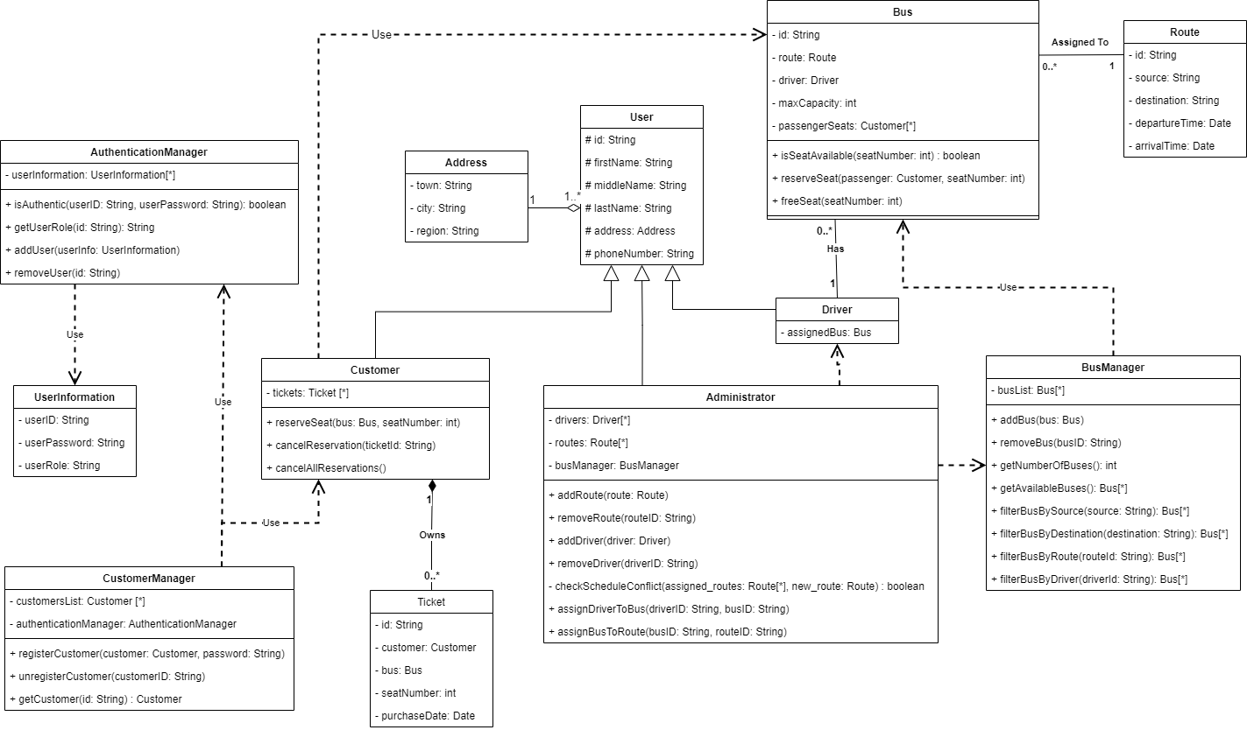
Initial Design

Slide 26
Removed Classes

Slide 27
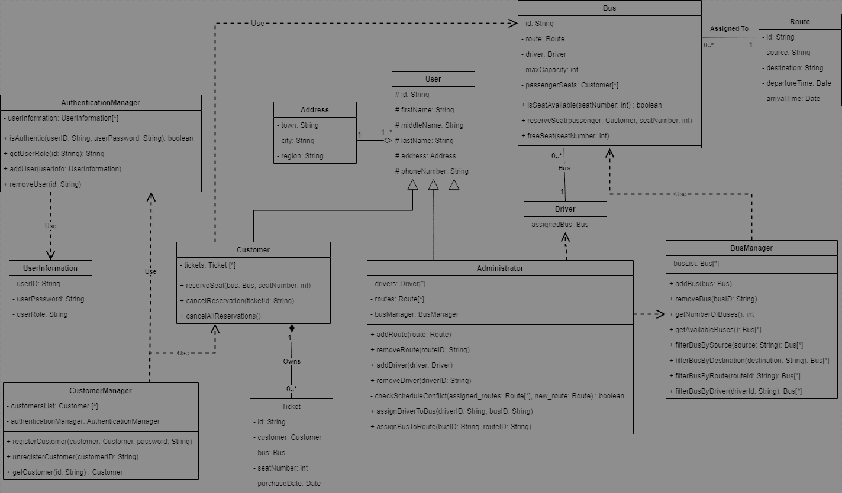
Removed Classes

Slide 28
Removed Classes

Slide 29
Removed Classes

Slide 30


